Slide 1
Search engine using web annotations
Project part-I
Project no.- 41
Anubha Srivastava(161B038)
Kartikae Mishra(161B107)
Ritik Vishwakarma(161B179)

Slide 2

Search Engine-
Search engine is a service that allows Internet users to search for content via the World Wide Web (WWW). A user enters keywords or key phrases into a search engine and receives a list of Web content results in the form of websites, images, videos or other online data.
The list of content returned via a search engine to a user is known as a search engine results page (SERP).

Slide 3
Stages in information retrieval
Finding documents: It is potentially needed to find interesting documents on the Web consists of millions of documents, distributed over tens of thousands of servers.
Formulating queries: It needed to express exactly what kind of information is to retrieve.
Determining relevance: The system must determine whether a document contains the required information or not.

Slide 4
Types of Search Engine
On the basis of working, Search engine is categories in following group :-
Crawler-Based Search Engines
Directories
Hybrid Search Engines
Meta Search Engines

Slide 5
Crawler-Based Search Engines
It uses automated software programs to survey and categories web pages , which is known as ‘spiders’, ‘crawlers’, ‘robots’ or ‘bots’.
A spider will find a web page, download it and analyses the information presented on the web page. The web page will then be added to the search engine’s database.
When a user performs a search, the search engine will check its database of web pages for the key words the user searched.
The results (list of suggested links to go to), are listed on pages by order of which is ‘closest’ (as defined by the ‘bots).

Slide 6
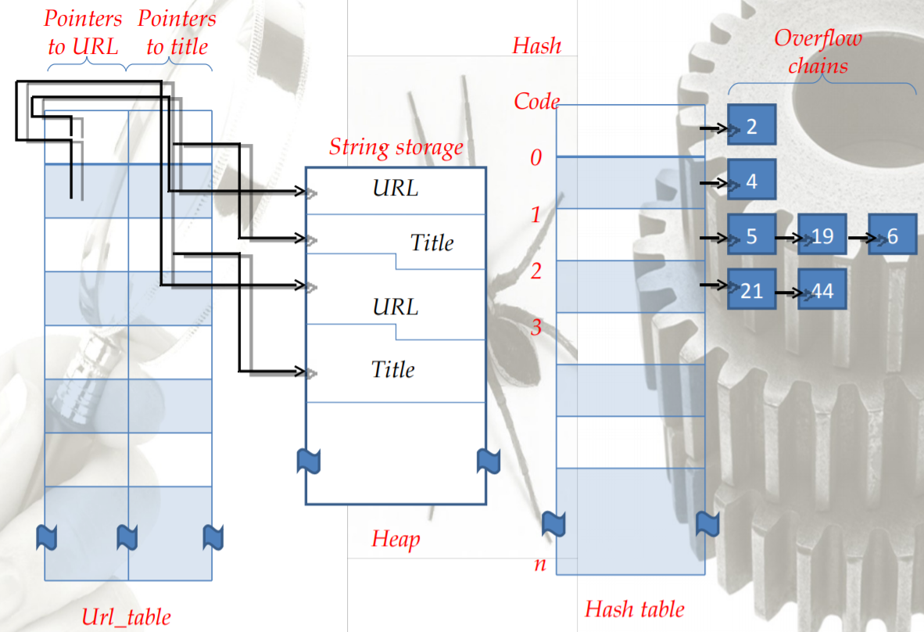
Data structure for crawler

Slide 7
Directories
A ‘directory’ uses human editors who decide what category the site belongs to.
They place websites within specific categories or subcategories in the ‘directories’ database.
By focusing on particular categories and subcategories, user can narrow the search to those records that are most likely to be relevant to his/her interests.
The human editors comprehensively check the website and rank it, based on the information they find, using a pre-defined set of rules.

Slide 8
Hybrid Search Engines
Hybrid search engines use a combination of both crawler-based results and directory results.
Examples of hybrid search engines are:
Yahoo (www.yahoo.com)
Google (www.google.com)

Slide 9
Meta Search Engines
Also known as Multiple Search Engines or Metacrawlers.
Meta search engines query several other Web search engine databases in parallel and then combine the results in one list.
Examples of Meta search engines include:
Metacrawler (www.metacrawler.com)
Dogpile (www.dogpile.com)

Slide 10
Searching is done by procedure, procees_url as follows :-
It hashes the URL to see if it is already present in url_table. If so, it is done and returns immediately.
If the URL is not already known, its page is fetched.
The URL and title are then copied to the heap and pointers to these two strings are entered in url_table.
The URL is also entered into the hash table.
Finally, process_url extracts all the hyperlinks from the page and calls process_url once per hyperlink, passing the hyperlink’s URL as the input parameter

Slide 11
Web Annotations-
A web annotation is an online annotation associated with a web resource, typically a web page. With a Web annotation system, a user can add, modify or remove information from a Web resource without modifying the resource itself. The annotations can be thought of as a layer on top of the existing resource, and this annotation layer is usually visible to other users who share the same annotation system.

Slide 12
Web annotations can be used for following purpose-
To rate a Web resource, such as by its usefulness, user-friendliness, suitability for viewing by minors.
To improve or adapt its contents by adding/removing material.
As a collaborative tool, e.g. to discuss the contents of a certain resource.
As a medium of artistic or social criticism, by allowing Web users to reinterpret, enrich or protest against institution or ideas that appear on the Web.
To quantify transient relationships between information fragments.

Slide 13
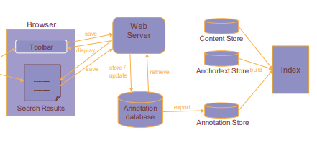
Search engine using web annotations
When user enters some words in search engine, system fetches automatically those pages which contain those words this happens due to web annotation. Web annotation has become one of the ongoing research topics.
We here proposed a system where user will enter search keywords of content or image. System will match the keyword with annotation if system finds matching content or image. System will display those content and image to user. We here used an effective algorithm to generate query result page or search result records based on a user’s query. User can search any details faster. System is user friendly, any user can use the system.

Slide 14
Application Programming Interface(API’s)
API is an abbreviation for Application Programming Interface which is a collection of communication protocols and subroutines used by various programs to communicate between them. A programmer can make use of various API tools to make its program easier and simpler. Also, an API facilitates the programmers with an efficient way to develop their software programs.
A developer extensively uses API’s in his software to implement various features by using an API call without writing the complex codes for the same. We can create an API for an operating system, database systems, hardware system, for a JavaScript file or similar object oriented files. Also, an API is similar to a GUI(Graphical User Interface) with one major difference.

Slide 15
Types of APIs
WEB APIs: A Web API also called as Web Services is an extensively used API over the web and can be easily accessed using the HTTP protocols. A Web API is an open source interface and can be used by a large number of clients through their phones, tablets. or PC’s.
LOCAL APIs: In this types of API, the programmers get the local middleware services. TAPI (Telephony Application Programming Interface), .NET are common examples of Local API’s.
PROGRAM APIs: It makes a remote program appears to be local by making use of RPC’s (Remote Procedural Calls). SOAP is a well-known example of this type of API.

Slide 16
Advantages and Disadvantage of API’s
Advantages
Disadvantages
Efficiency: API produces efficient, quicker and more reliable results than the outputs produced by human beings in an organization.
Flexible delivery of services: API provides fast and flexible delivery of services according to developers requirements
Integration: The best feature of API is that it allows movement of data between various sites and thus enhances integrated user experience.
Cost: Developing and implementing API is costly at times and requires high maintenance and support from developers.
Security issues: Using API adds another layer of surface which is then prone to attacks, and hence the security risk problem is common in API’s.

Slide 17
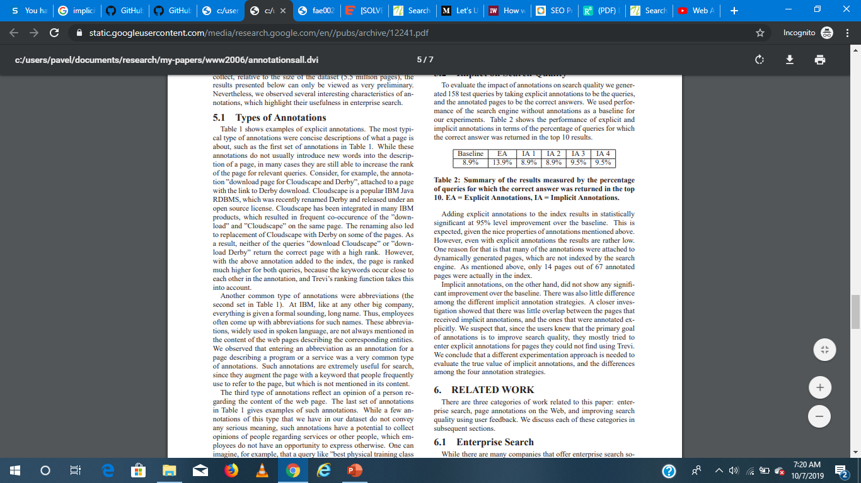
Impact on Search Quality
Adding explicit annotations to the index results in statistically significant at 95% level improvement over the baseline.
Implicit annotations, on the other hand, did not show any significant improvement over the baseline. There was also little difference among the different implicit annotation strategies.
Table 2
Baseline-Performance of the search engine without annotations as a baseline

Slide 18
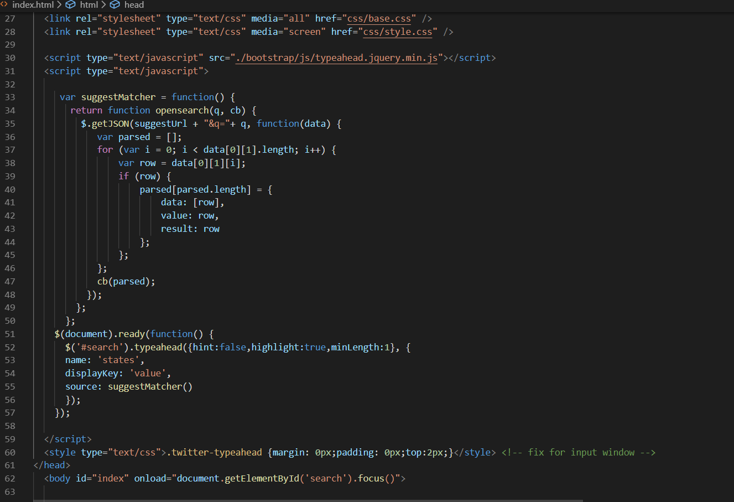
Code snapshot-

Slide 19
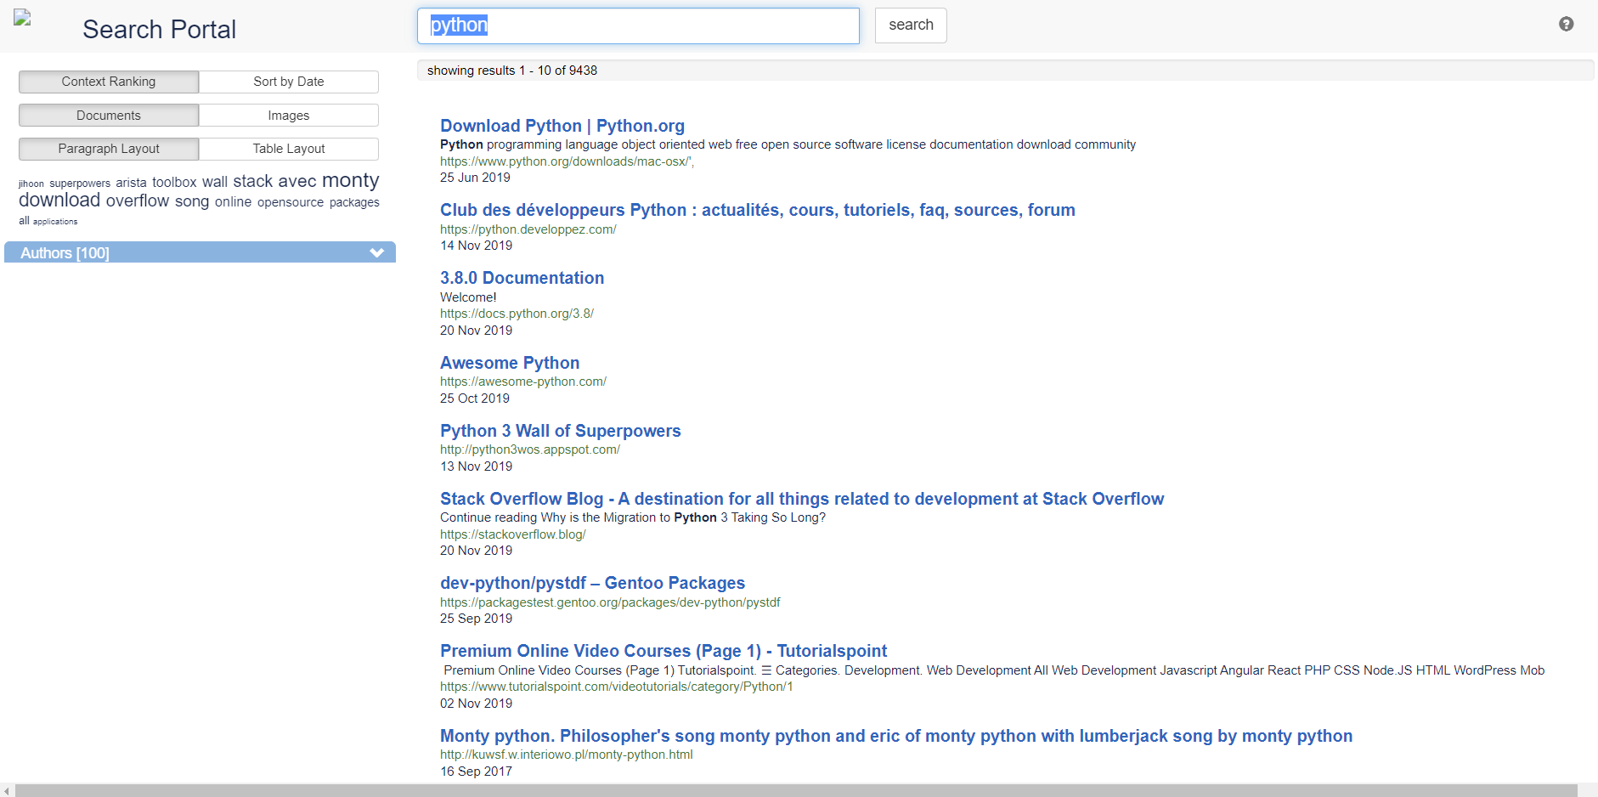
Working Model-

Slide 20
Thank You

